Slide 1
Peer Review
Revision is improving, not fixing.
You are not trying to “fix” your paper, you are making it better.
In a first draft, you are still getting your thoughts together. The second draft may be much different than the original. This is part of the process and a good thing.

Slide 2
Round 1
Robert and Sarah
Chani and Rina
Max and Drew
Jamarcus and Joseph
Thomas and James
Carly and Nate Harvey
Matt & Matt
Nathan and Coby
Aubrey and Chris
Carly and Mark

Slide 3
Title
Does the essay have a title?
If not, try to come up with one. It should denote the topic of the paper.

Slide 4
INTRODUCTION
Does it have a hook?
Does it introduce the topic with background information?
Does it have a clear, specific thesis?
Does it outline the structure of the paper?

Slide 5
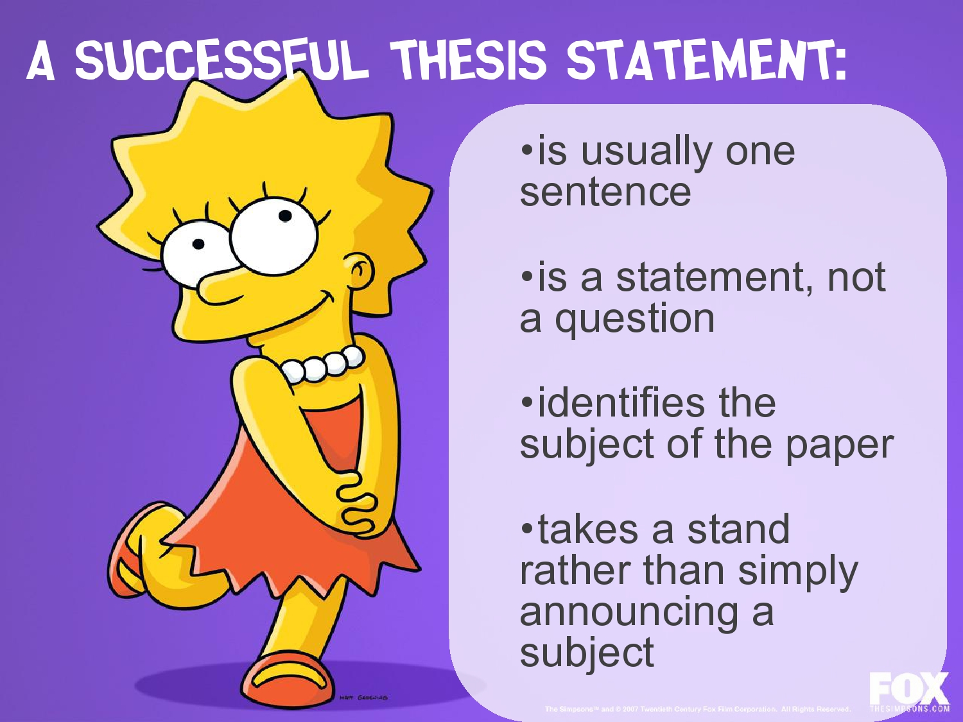
Notes:
Is the thesis statement clear? Does it take a stand?

Slide 6

TOPIC SENTENCES
Notes:
Topic sentences

Slide 7
TOPIC SENTENCES
A Topic Sentence should:
  State the purpose of the paragraph
  Transition from the previous paragraph
  Reference the thesis

Slide 8
Topic Sentences
Dependent clause that references previous paragraph beginning with a transitional word or phrase, independent sentence that states the purpose of this paragraph using a key word that connects the point of this paragraph to the thesis of the paper.
Transitional phrases:
  Addition: In addition, Furthermore, Moreover
  Comparison: In the same way, Likewise, Similarly
  Contrast: While, Contrary to, Though, Notwithstanding

Slide 9
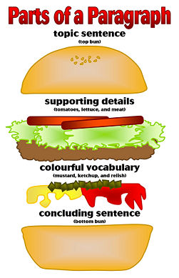

Slide 10
Body Paragraphs
Does each paragraph have a purpose?
Does the paragraph have enough evidence to support its claim?
Is it using the BEST textual evidence available?

Slide 11
CITATIONS
Does every citation from the text have a citation with the author and the title?
If there is a quote more than 4 lines, does it match block-quote format guidelines?
Does the in-text citation take the reader directly to the works cited?

Slide 12
Evidence
Is every quote introduced and analyzed?
Do you explain why this evidence supports your claim and, overall, your thesis?

Slide 13
Conclusion
Is it clear when you have reached the conclusion?
Does it restate the thesis?
Does it summarize all the main points in the paper?
Does it make a move outward, explaining possible implications about this problem/solution and why this issue is important?

Slide 14
Now – without looking back – summarize the paper in a few sentences.
Compare to your first summary. What is different? What is missing in the topic sentences?

Slide 15
Give the paper back, look over comments, then talk to each other about the comments.

Slide 16
Round 2
Kenzi & Lauren
Shannon & Michelle
Francesca & Hanley
Derek & Brianna
Jacob & Matthew
Luke & Calvin
Joe H. & Dan
Danny & Jake
Garrett & Joe G.
Logan & Rachel & Kimiko

Slide 17
Now with your own paper in front of you, write over it how you might revise. Write down your plans/ideas.

Slide 18
Introduction
  Introduce the topic
  Thesis very clear
  Outline the structure of the paper
Using Sources
  Is it a SECONDARY source?
  Are they introduced sufficiently?
  Does the author do something with the idea? (rather than plunking a quote down and moving on)
Topic sentences:
  Do they transition, state the purpose of the paragraph, and reference the thesis?

